Slide 1

Know Your Rights: Understanding the Student Code of Conduct
Student Workshop
State College of Florida

Slide 2
Workshop Objectives
By the end of this workshop, you will be able to:
• Identify key student rights
• Understand the conduct process
• Explain appeal options
• Locate campus resources

Slide 3

Why Student Rights Matter
Student rights help ensure fairness, respect, and due process while maintaining a safe and productive learning environment.

Slide 4
Student Rights at SCF
• Right to fair treatment
• Right to notice of allegations
• Right to review information related to a case
• Right to participate in the process
• Right to appeal decisions
• Right to have an advisor/support person

Slide 5

What is Due Process?
Due process means students receive notice, an opportunity to respond, and a fair review before decisions are made.

Slide 6
The Student Conduct Process
1. Incident
Reported
The Dean of Students Office will open a case.
2. Review of information
The Dean of Students Office will review all the information.
3. Student meeting
A meeting will be scheduled with the student(s) involved.
4. Resolution or hearing
The issue may be resolved through an informal process or a formal hearing.
5. Outcome issued
The Dean of Students office will send a written outcome letter.
6. Appeal (if applicable)
Student may appeal – refer to the code of conduct for more information

Slide 7
Your Responsibilities
• Read college communications
• Respond to requests for meetings
• Be truthful during the process
• Follow college policies and procedures

Slide 8

Reporting Concerns
Students may report concerns involving misconduct, safety issues, discrimination, harassment, or other policy violations through appropriate college channels.
SCF Dean of Students
DeanOfStudents@SCF.edu
941-752-5267
SCF Public Safety
PublicSafety@SCF.edu
941-752-5550

Slide 9
Knowledge Check #1
Read the statement and then click your mouse to reveal the answer
True or False:
Students have the right to know what allegations have been made against them.
Answer: True!
Notes:
Answer: True

Slide 10

Case Study
A student receives notice of an alleged conduct violation.
Think about these questions:
• What rights does the student have?
• What should the student do next?

Slide 11
Knowledge Check #2
Which of the following is a student right?
A. Notice of allegations
B. Opportunity to respond
C. Appeal process
D. All of the above
Read the statement and then click your mouse to reveal the answer
Answer: D. All of the above
Notes:
Answer: D

Slide 12
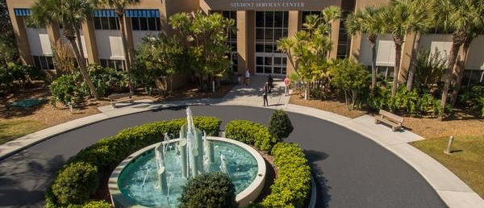
Campus Resources
• Dean of Students Office deanofstudents@scf.edu
• Academic Advising CollegeAndCareerSuccess@SCF.edu
• Counseling Services SCFCare@scf.edu
• Public Safety PublicSafety@SCF.edu
• Coordinator, Student CARE Services SCFCare@scf.edu

Slide 13
Reflection
What new information did you learn?
How can understanding your rights help you succeed at SCF?

Slide 14
Workshop Summary
You learned about…
• Student rights
• Due process
• Conduct procedures
• Appeals
• Campus resources

Slide 15
Thank you!
Got Questions?
Please reach out to the
Dean of Students Office
deanofstudents@scf.edu

